Slide 1


FUTURE PROOFER
AI foresight for smarter careers and stronger businesses.
Contact: info@fortizotechnologies.com | Date: 8/11/2025

Slide 2

The Problem
Career Blindspots
Limited access to career and business foresight tools leaves professionals navigating uncertainty without clear direction.
Youth Unemployment
Talented young people remain underutilized, lacking guidance to match their skills with emerging opportunities.
SME Struggles
Small and medium enterprises struggle to anticipate market shifts, competitive threats, and economic risks.
Data Scarcity
Scarce access to localized trend data and AI-powered insight tools limits strategic decision-making.
"People are planning blind in a fast-changing world."

Slide 3
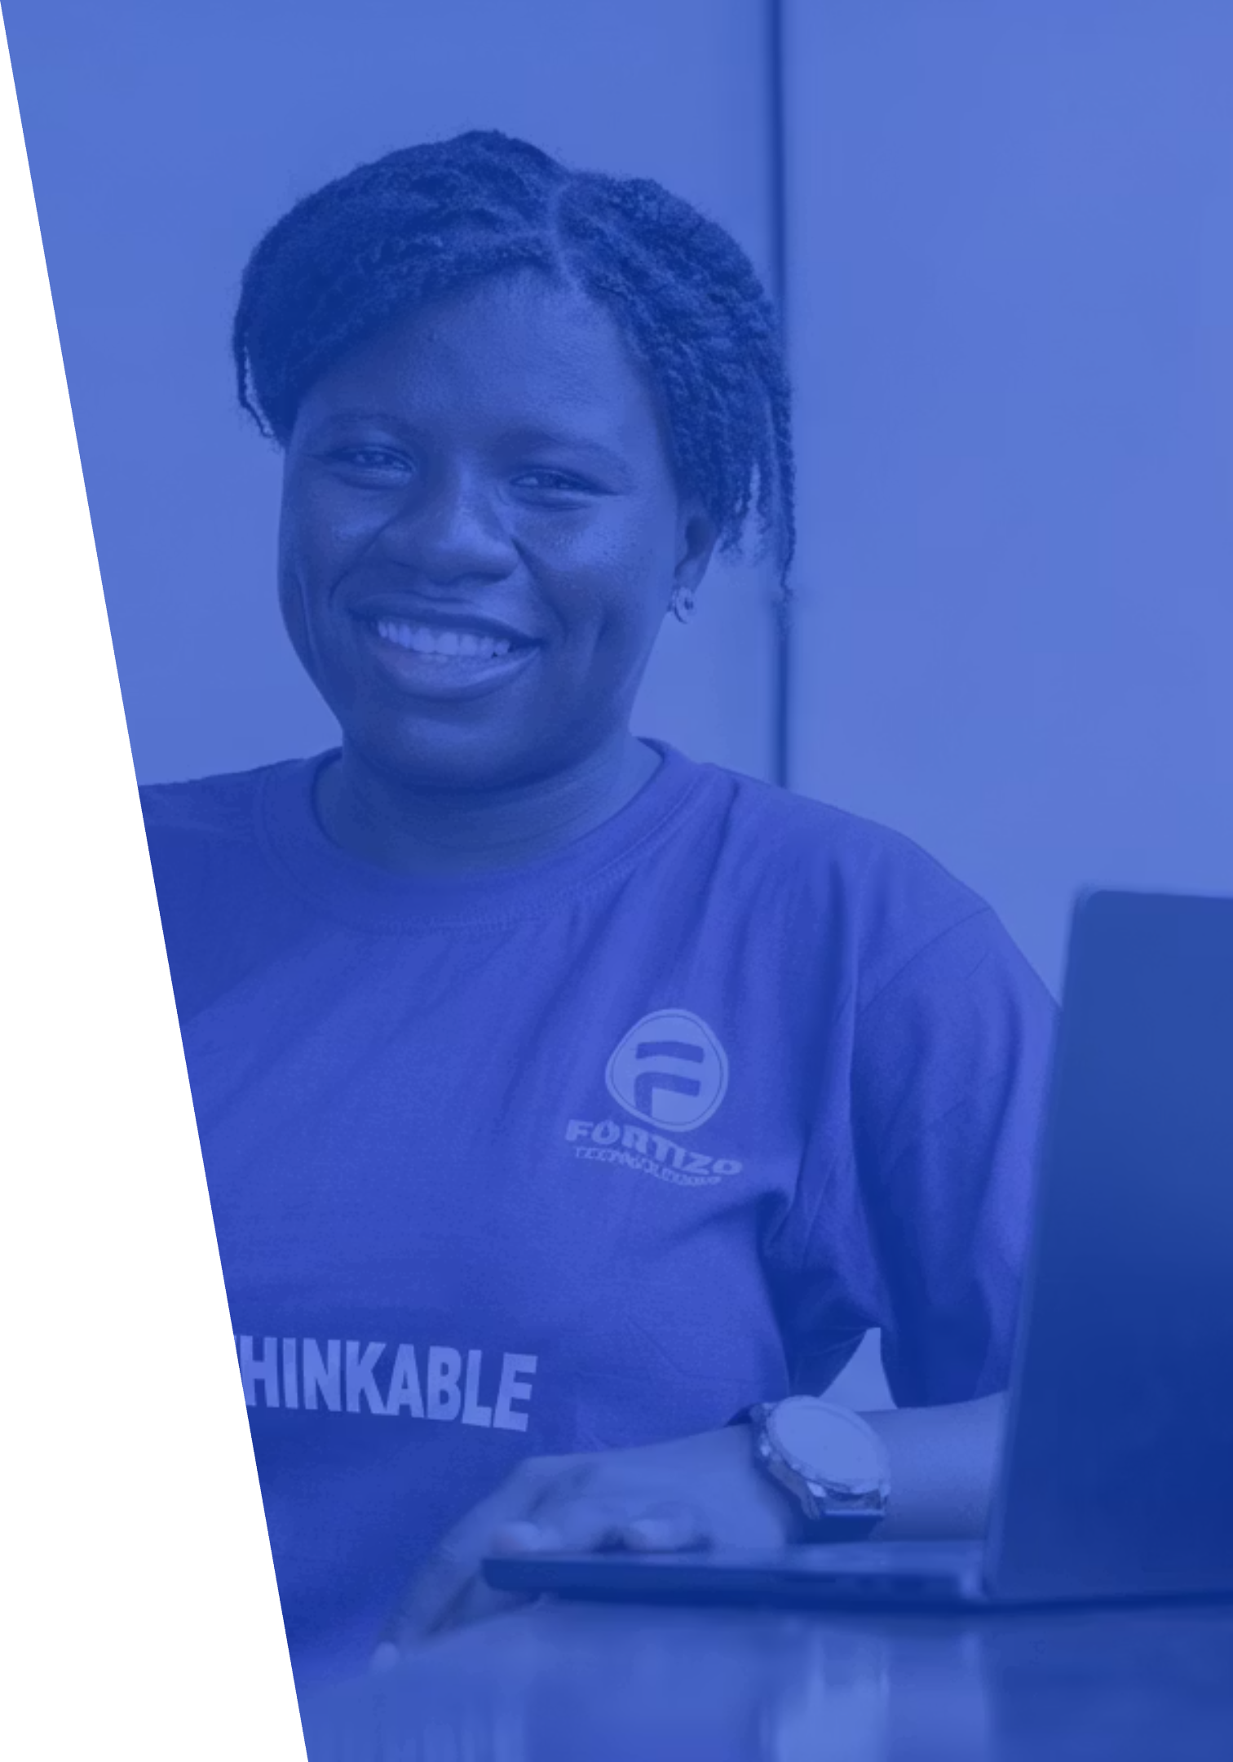
The Solution
Future Proofer is an AI-powered platform that transforms uncertainty into opportunity. Our intelligent system analyzes economic patterns and skill trends across West Africa, delivering personalized strategies that help individuals and businesses thrive in tomorrow's economy.
01
02
Analyze Trends
Generate Insights
Our AI engine processes economic and skill market data to identify emerging patterns and opportunities.
We translate complex data into clear, actionable recommendations tailored to your unique context.
03
Future-Proof Success
Users receive personalized strategies to navigate change, supported by free masterclasses that bridge digital divides.

Slide 4
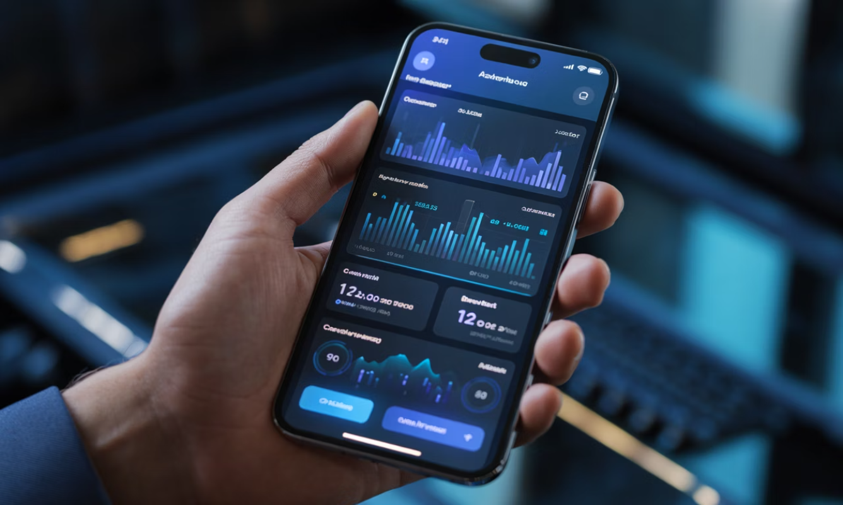
Product Overview
Core Modules
Career Foresight Engine
Business Strategy Predictor
Predictive analytics for career trajectory planning and opportunity identification.
Market intelligence and competitive analysis to anticipate business landscape changes.
Skill Path Advisor
Market Insights Dashboard
Personalized learning roadmaps aligned with emerging market demands.
Real-time visualization of trends, opportunities, and risks across sectors.
Access Anywhere
Platforms: Web + Mobile
Versions: Freemium for individuals | Licensed for organizations
AI Assistant (BusinessMate)
Conversational AI guide providing on-demand strategic advice and support.

Slide 5

Market Opportunity
1M+
50K+
15
Working-Age Professionals
Active SMEs
ECOWAS Countries
Small and medium enterprises requiring predictive business intelligence tools.
Expansion opportunity across West African nations with similar challenges.
Sierra Leone's educated workforce seeking career advancement and strategic guidance.
Growth Drivers
Target Market
Market Trends
Institutional Demand
Launch in Sierra Leone with rapid expansion planned across ECOWAS region, including Gambia, Liberia, and Ghana.
Accelerating AI adoption across Africa combined with surging youth demand for digital skills and foresight capabilities.
Government and NGO employment programs actively seeking scalable solutions for workforce development.

Slide 6

Competitive Edge
Competitor
Limitation
Future Proofer Advantage
LinkedIn Learning
Global focus, lacks local context
Localized foresight for West Africa
Coursera
Skills-only, no predictive strategy
Predictive strategy engine
Local incubators
Non-digital, limited scale
AI automation + social impact
Key Differentiators
First-Mover Advantage
Human + Machine Synergy
Ecosystem Integration
The first AI foresight tool specifically tailored for Sierra Leone's unique economic and social landscape.
Built on Fortizo's proven ThinkForge learning ecosystem with established partnerships and trust.
We combine powerful AI analytics with human expertise and local knowledge for superior insights.

Slide 7




Business Model
B2C Subscriptions
Individual users access premium features through flexible monthly plans starting at $9.99.
B2B Licenses
Organizations unlock enterprise capabilities with annual licenses at $500 per organization.
Additional Revenue Streams
Sponsored Reports
Training Partnerships
Grants & CSR
Industry-specific insights and white-label research commissioned by partners.
Co-branded masterclasses and workshops with educational institutions and corporations.
Strategic funding from development organizations and corporate social responsibility programs.

Slide 8

Go-To-Market Plan
1
Phase 1: Pilot Launch
Deploy in Sierra Leone, partnering with universities and SMEs to validate product-market fit and gather user feedback.
2
Phase 2: Regional Scale
Expand across West Africa to Gambia, Liberia, and Ghana, leveraging proven success metrics and testimonials.
Marketing Channels
Digital Marketing
Institutional Partnerships
Workshops & Events
LinkedIn thought leadership campaigns
Free masterclass series
University collaborations
Industry conferences
Facebook community building
Government program integration
Community outreach programs
Targeted content marketing
NGO workforce initiatives
Demo days for businesses.
Chamber of Commerce alliances
Influencer partnerships

Slide 9

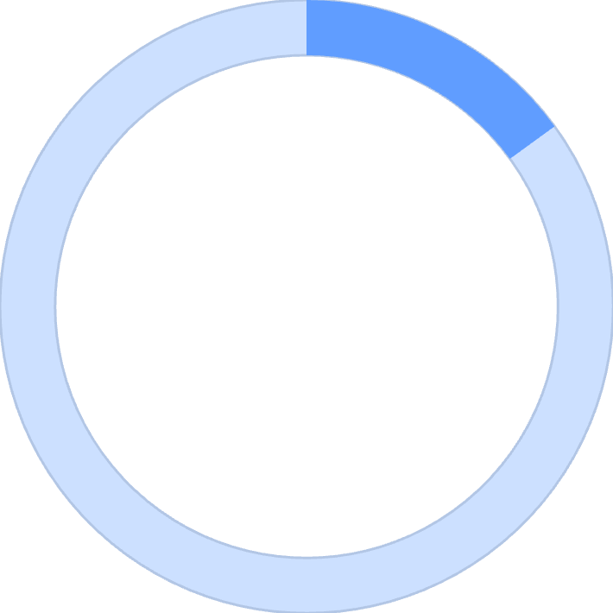

Impact & Social Value
AI for Social Transformation
Future Proofer isn't just about profit—it's about empowerment. We're building a platform that democratizes access to strategic foresight, creating pathways to prosperity for individuals and businesses across West Africa.
10000+
2000+
15
Youths Trained
SMEs Supported
Countries Reached
Young people equipped with digital planning and foresight skills for the future economy.
Small businesses empowered with AI-driven insights to compete and grow sustainably.
ECOWAS nations gaining access to localized, actionable intelligence tools.
Our Commitment: Making sophisticated AI foresight accessible to everyone, regardless of economic background, to create lasting positive change across communities.

Slide 10

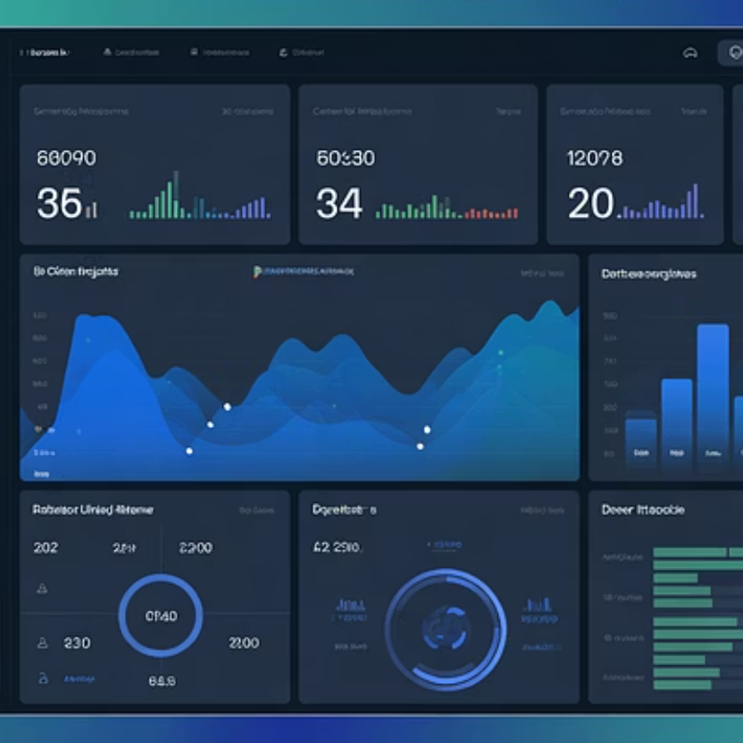
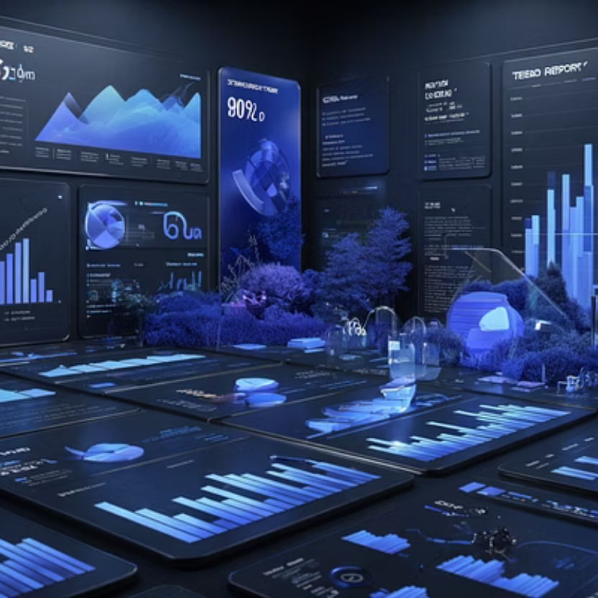
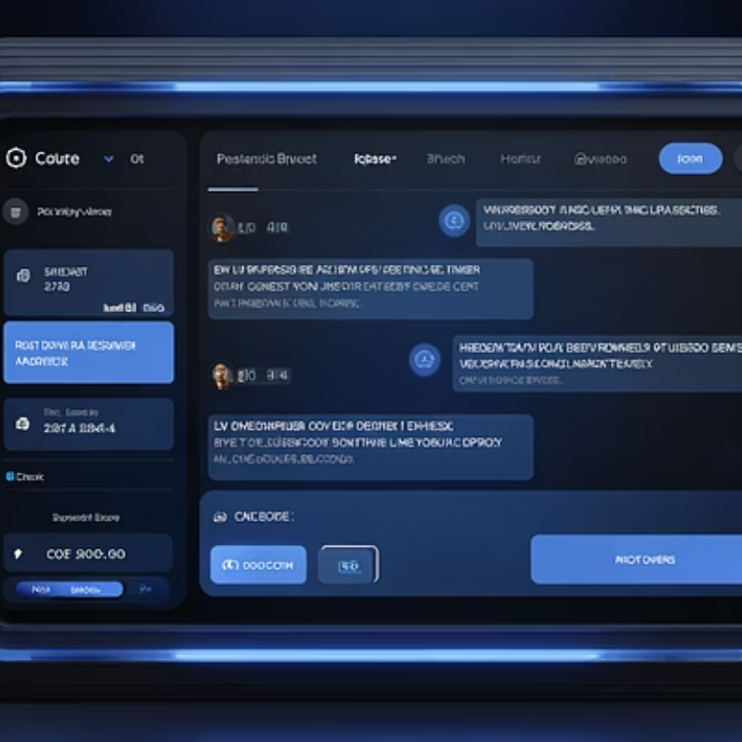

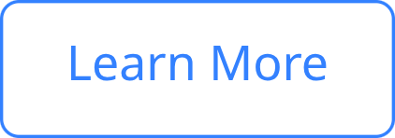
Product Screens Preview
Experience Future Proofer
Ready to Transform Your Future?
Our intuitive interface transforms complex AI insights into clear, actionable guidance. From personalized dashboards to intelligent conversations with BusinessMate, every interaction is designed to empower smarter decisions.
Join us in revolutionizing career and business planning across West Africa.

Slide 11
Traction & Metrics
AI for Social Transformation
Future Proofer isn't just about profit—it's about empowerment. We're building a platform that democratizes access to strategic foresight, creating pathways to prosperity for individuals and businesses across West Africa.
10000+
2000+
15
Youths Trained
SMEs Supported
Countries Reached
Young people equipped with digital planning and foresight skills for the future economy.
Small businesses empowered with AI-driven insights to compete and grow sustainably.
ECOWAS nations gaining access to localized, actionable intelligence tools.
Our Commitment: Making sophisticated AI foresight accessible to everyone, regardless of economic background, to create lasting positive change across communities.

